Slide 1
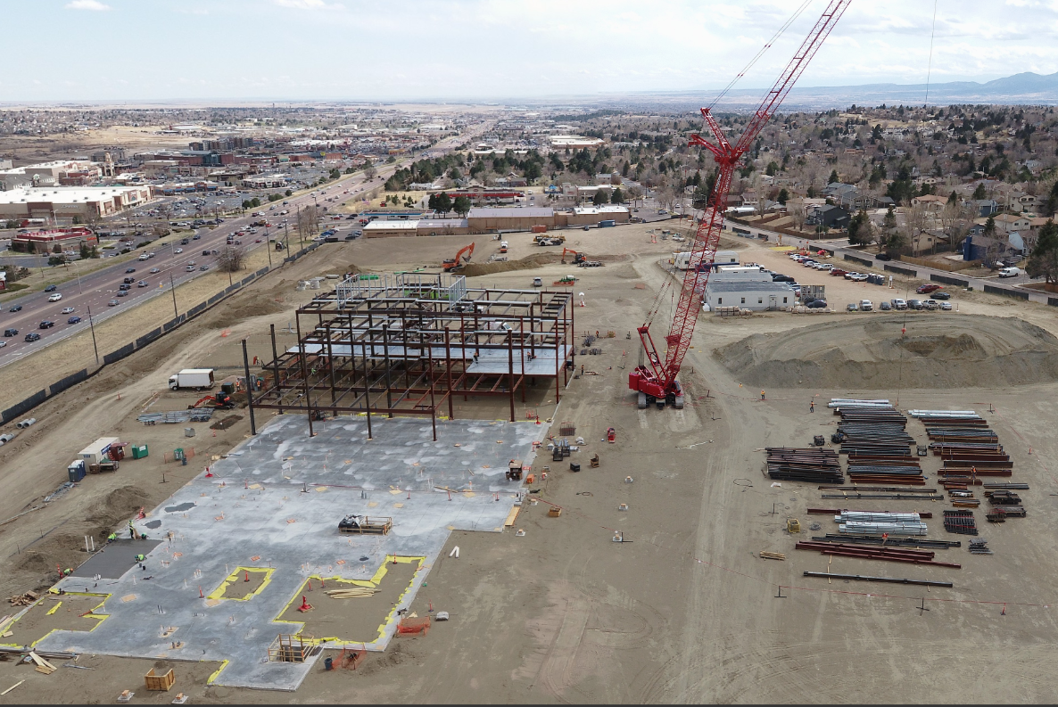
Weather Impacts on Construction Projects
Introduction: (Motivation and Drivers)
Weather has considerable impacts on construction projects including:
Schedule delays
Escalation of Equipment Costs
Delay Damages, Non-Payment and Lawsuits
Inefficient use of manpower and equipment
Ideal Situation – Dry weather, no wind, long summer days (10 hour workdays)

Slide 2

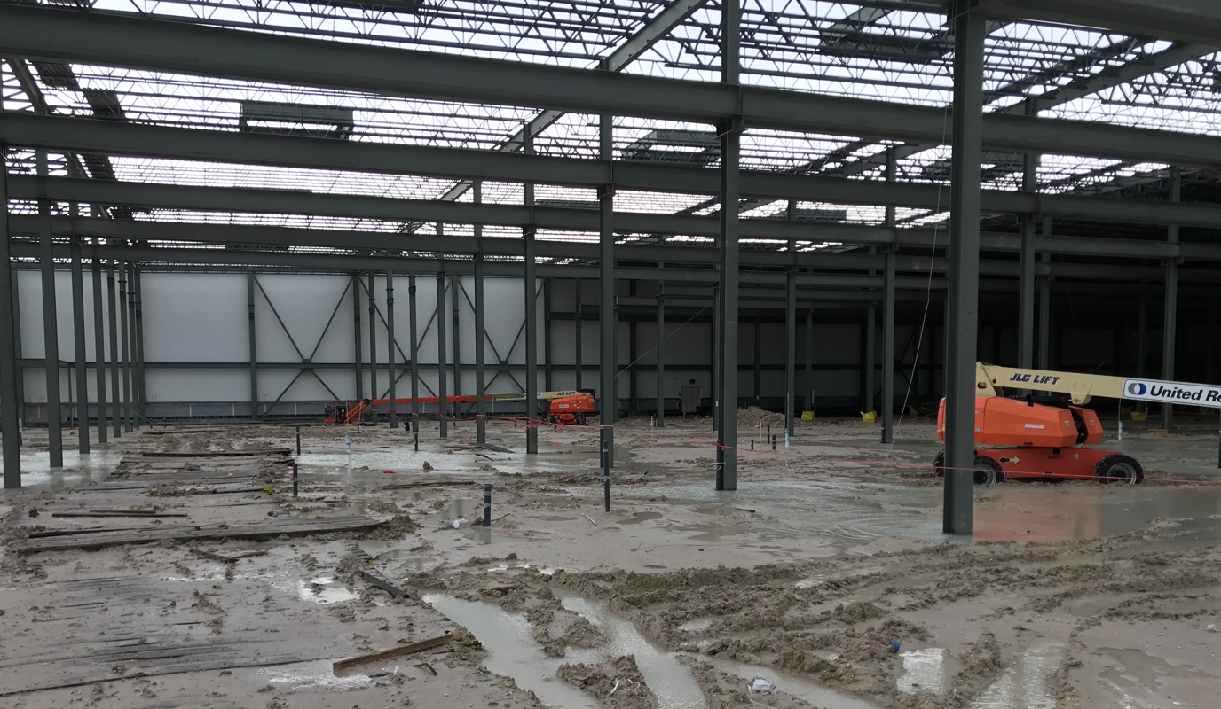
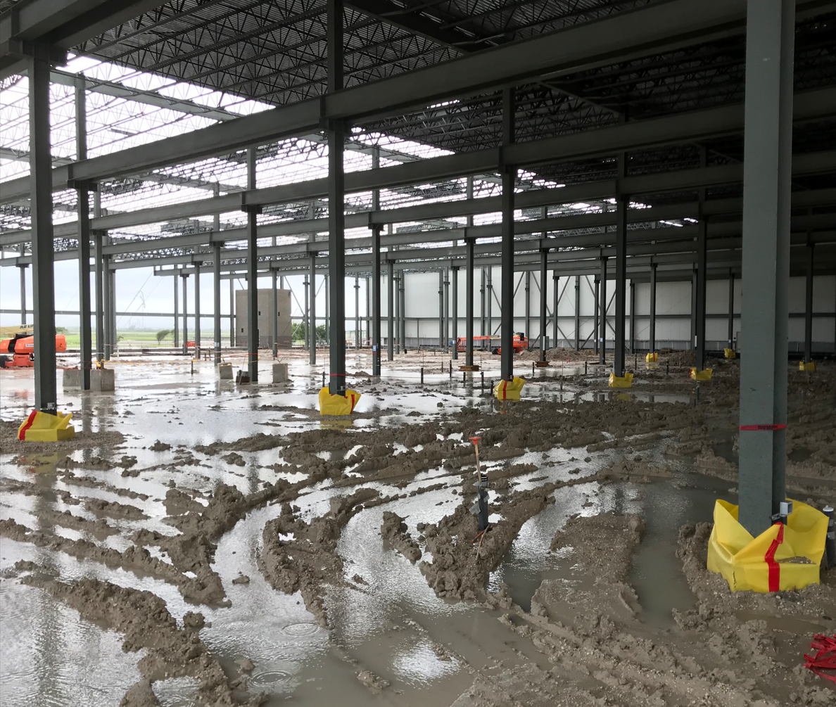



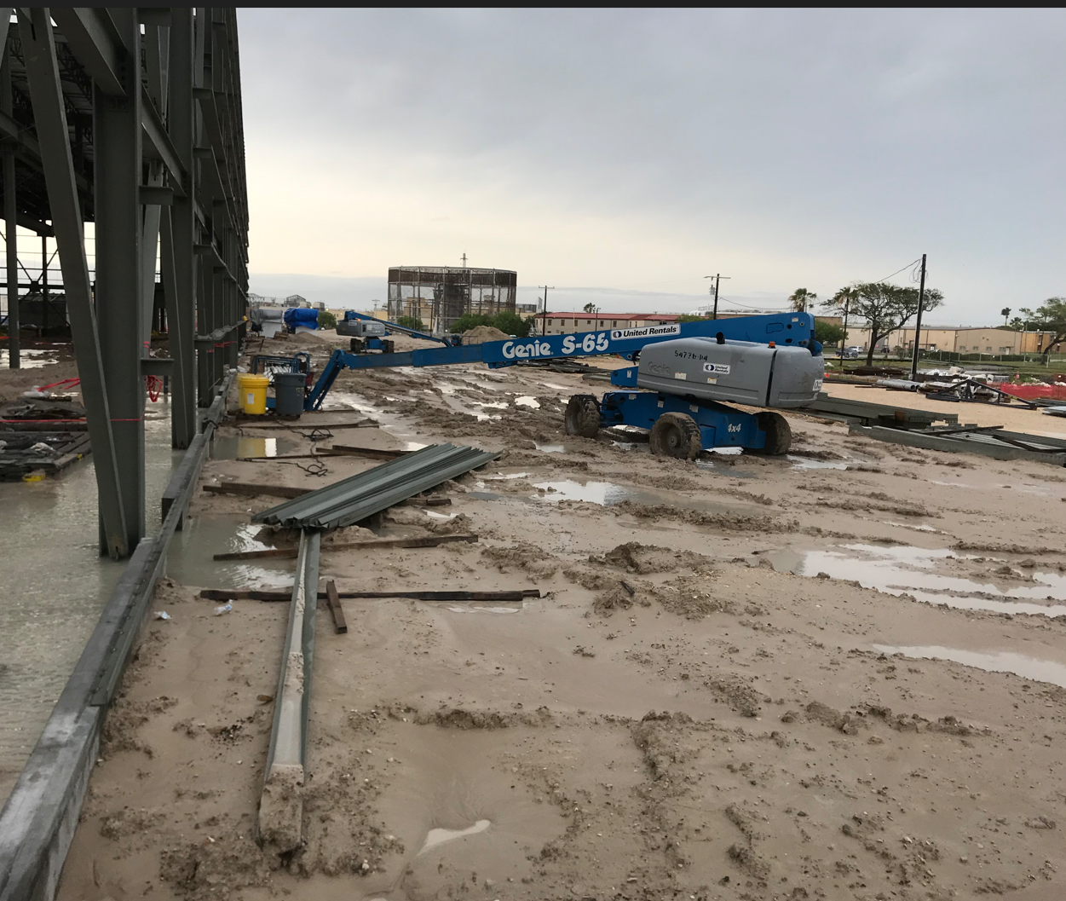
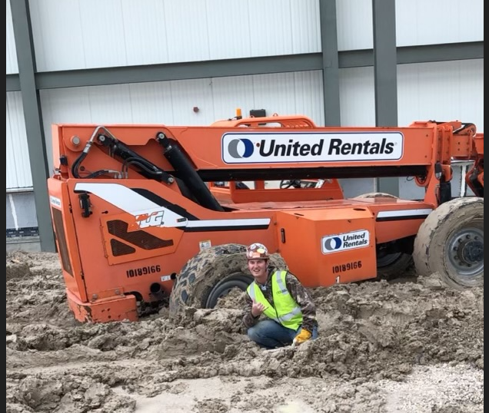

Weather Impacts on Construction Projects

Slide 3
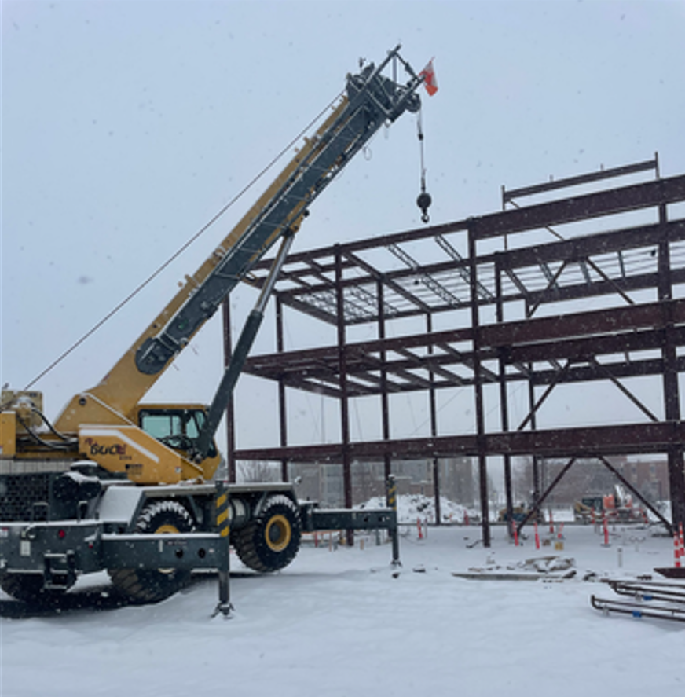
Weather Impacts
Weather Day – The general definition for a delay caused by weather which impact the ability of a field crew to perform work for more than 50% of the work day.
HME, Inc. supplies Structural Steel for construction and we have fairly specific definitions for “Weather Days”
Rain – Rain is typically the most common and restrictive weather condition which shuts down construction sites.
Snow – Snow is treated similar to rain in shutting down construction sites. Accumulation of snow is a safety issue.
High Winds – For safety reasons, cranes are typically not allowed to operate in wind speeds above 25 mph. High winds also make handling of roof and floor decking unsafe.
Low Temperatures impact welding operations:
Below 32 deg. F requires preheating of weld joint to 50 deg. F.
Below 0 deg. F restricts all welding

Slide 4
Weather Variables Used
High Wind = wind speed over 15mph
Yellow condition. Crane must shut down, but other work can be performed
Rain
Red condition. All work must shut down.
Snow
Red condition. All work must shut down.
Cold but good weather = temperatures below 32 degrees
Blue condition. No rain, snow, or high wind
Extreme low temperatures = temperatures below 20 degrees
Blue condition. No rain, snow, or high wind
Good weather = all conditions not listed above
Green condition

Slide 5
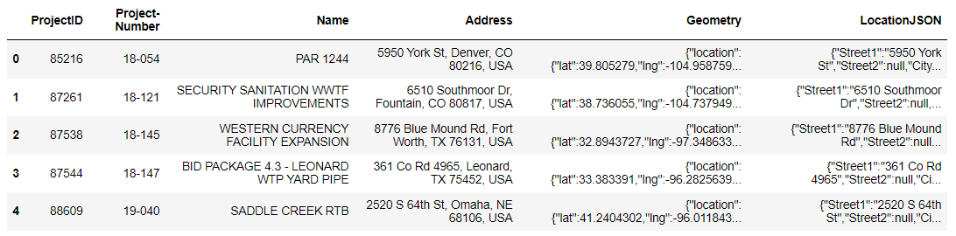
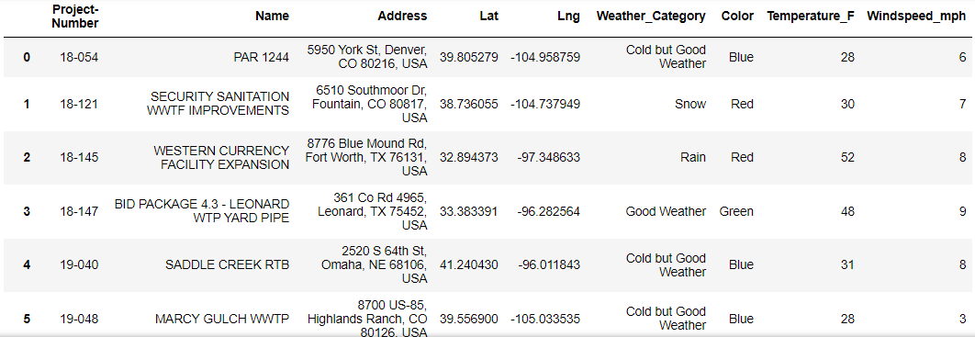
Data Resources
HMEOpenLargeJobs_20231202
CSV file of current projects with location
Weather API – OpenWeatherMap
Current weather
5 day/3 hour forecast
Original CSV file
Cleaned data frame

Slide 6
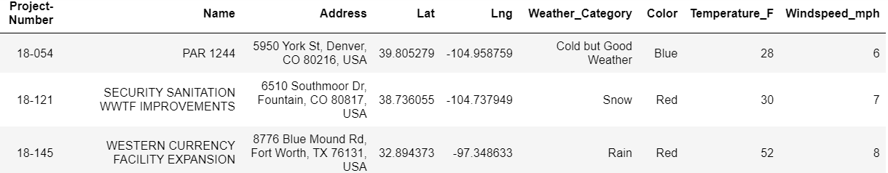
Data Prep Notebook
Step 1:
Deleted confidential and irrelevant information.
Step 2:
Parce latitude and longitude.
Remove projects with missing latitude and longitude.
244 active projects
Step 3:
Retrieve weather from open weather API
Categorize and color weather based on established variables.
Cold but good weather = Blue
Rain = Red
Snow = Red
High wind = Yellow
Good weather = Green
Step 4:
Send cleaned projects_weather_data and Weather_5Day_Forecast to csv files.

Slide 7
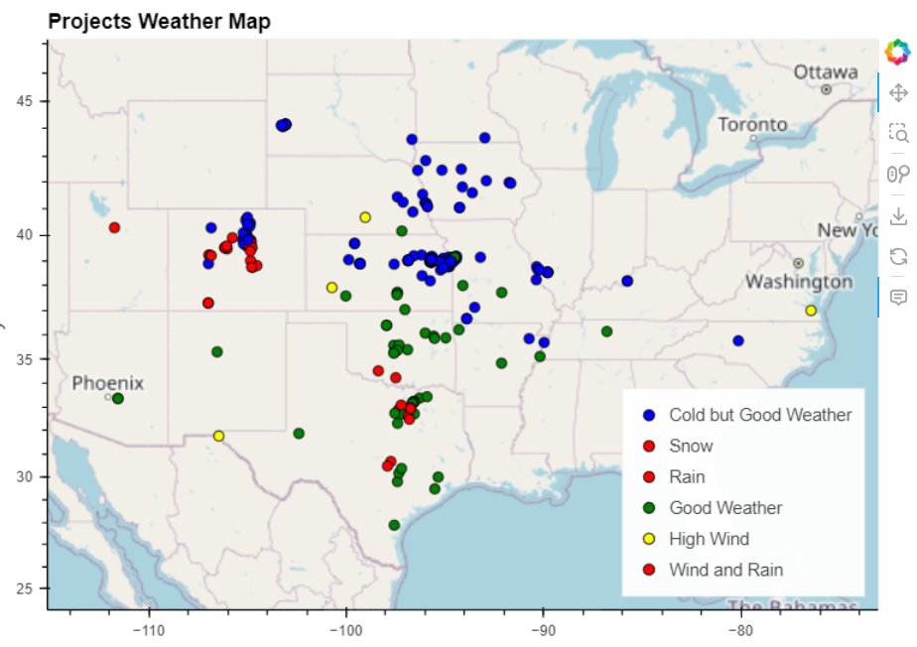
Weather Map
Hvplot was utilized to create a map with each project located with a dot colored by the current weather category provided in the projects_weather_data.csv generated in the data prep.

Slide 8
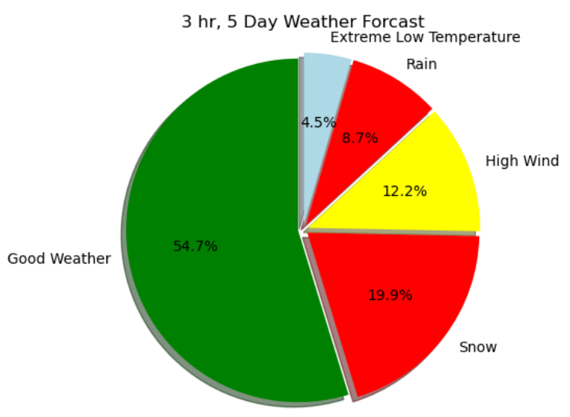
3 Hour 5 Day Forecast
Forecasted weather conditions were collected every 3 hours for 5 days between the hours of 6 am and 6 pm. These hours represent a construction workday. The pie chart details the forecast provided in the Weather_5Day_Forecast.csv generated in the data prep.

Slide 9
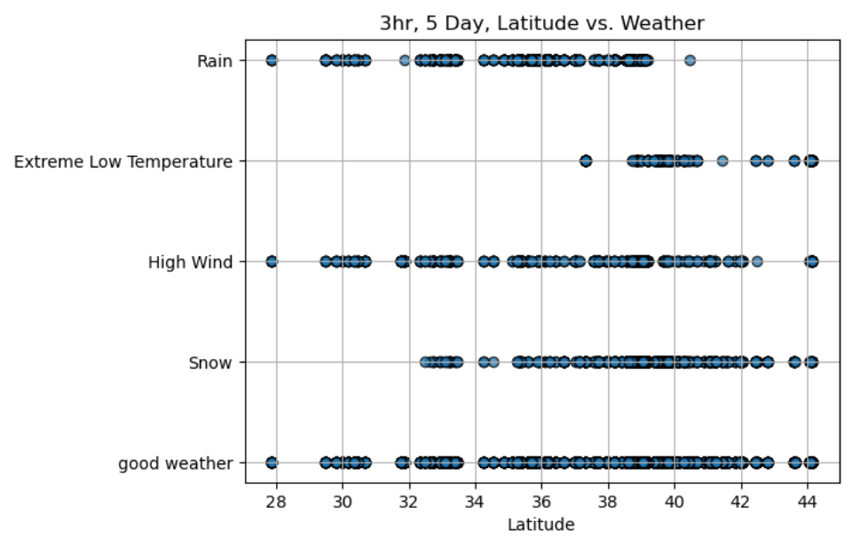
Latitude vs Forecasted Weather
The chart shows the relationship between latitude and weather conditions provided in the Weather_5Day_Forecast.csv generated in the data prep.
Extreme low temperatures appear to start around 38 deg latitude. Snow begins around 32 degrees latitude and rain ends around 40 deg latitude.

Slide 10
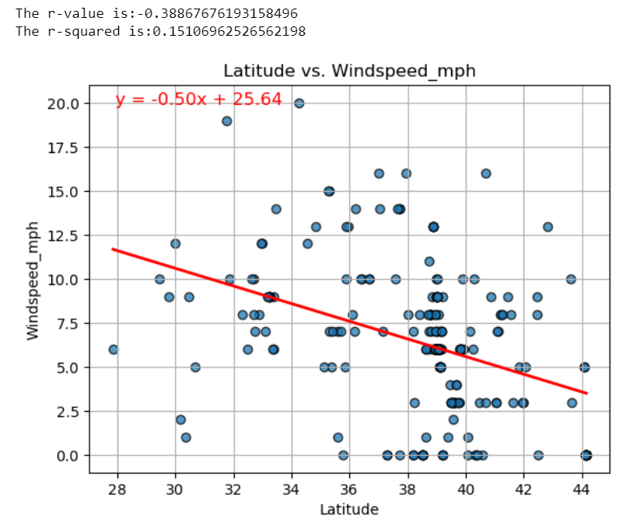
Current Latitude vs Windspeed
The plot shows the relationship between latitude and windspeed conditions provided in the projects_weather_data.csv generated in the data prep.
There is a weak to moderate (r-value -0.39) negative correlation between latitude and windspeed according to the scatter plot. The r-squared being 0.151 means that 15% of the target variance can be explained by the datasets.

Slide 11
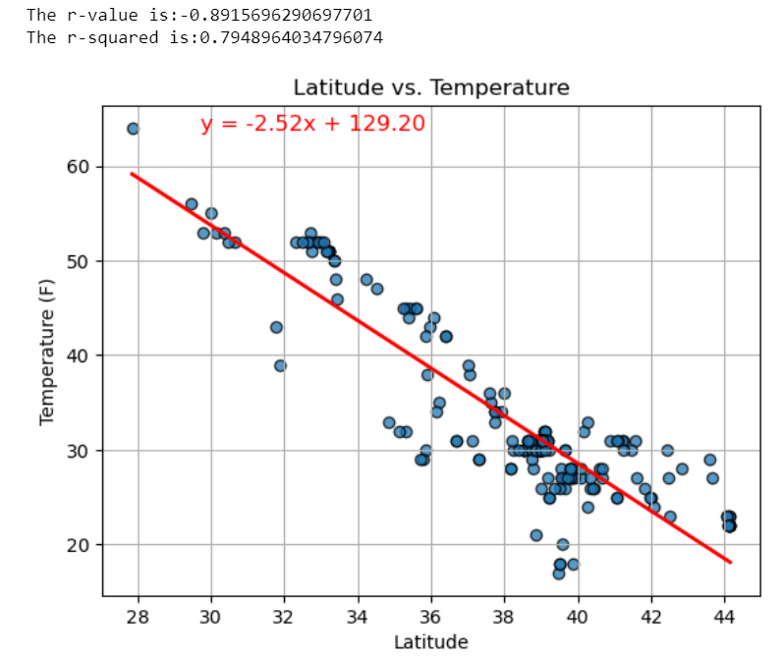
Current Latitude vs Temperature
The plot shows the relationship between latitude and temperature conditions provided in the projects_weather_data.csv generated in the data prep.
There is a strong negative correlation (r-value -0.89) between latitude and temperature according to the scatter plot. The r-squared being 0.79 means that 79% of the target variance can be explained by the datasets.

Slide 12
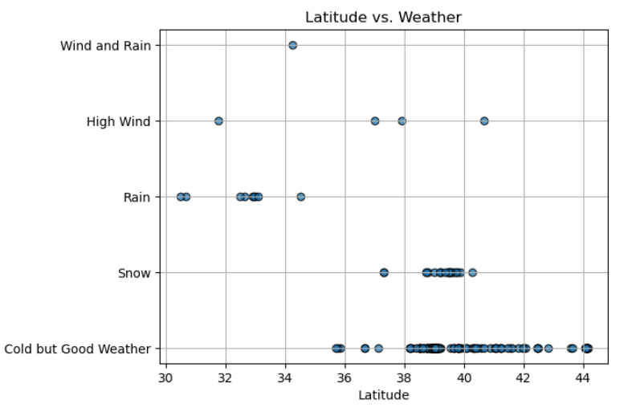
Current Latitude vs Weather
The chart shows the relationship between latitude and weather conditions provided in the projects_weather_data.csv generated in the data prep.
All projects between 30 to 35 degrees latitude had no snow and they were the only stations that recorded rainfall. The highest percentage concentration of good weather was recorded in projects located between 38 to 42 degrees latitude. It also recorded the highest percentage of projects that experienced a snow related weather. All projects located between 41 to 44 degrees latitude had cold but good weather, no snow, rain or high wind recorded. d]Both high wind and rain was only recorded between 30 – 35 degrees latitude.

Slide 13
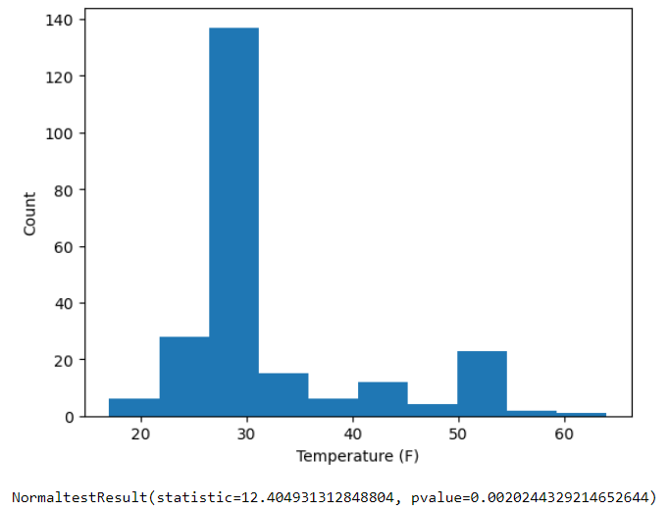
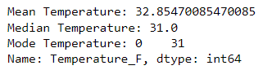
Summary Statistics for Current Temperature of all projects
The graph shows the temperatures provided in the projects_weather_data.csv generated in the data prep.

Slide 14
Conclusion
Latitude increases the number of weather days related to snow and extreme low temperatures.
Latitude slightly increases the chance for weather days related to wind.
The current mean temp for the 244 projects analyzed is 32.8 deg F.
The 5 day forecast indicates inclement weather will impact construction schedules 45% of the time between 6am and 6pm.

Slide 15
Project Assessment
We feel the project was extremely successful in identifying the usefulness of data analytics in construction specifically related to Weather Delays. However, to truly be a useful benefit for HME, we would need to examine the following:
Historical Weather patterns specific to project location during the timeframe the steel erection is scheduled.
Projected Weather Days could be used to predict additional costs related to weather in the estimate/bid.
If predecessor activities delay our erection schedule to a less desirable season we may be able to document weather related change order costs. I.E.
Winter conditions
Rainy Season
Seasonal Impacts could be addressed automatically in estimating software to include:
Additional equipment days related to Weather Days
Additional Per Diem days for employee living expenses
Additional days related to shortened workdays associated with daylight hours.
Daily weather conditions for the duration of the steel erection could be automatically documented and used to avoid:
Damages related to Schedule delays
Payment withholding
Lawsuits for delay of scheduled occupancy
I.E. Football Stadiums must be completed before the first home game.

